Slide 1
Paradigm Shift: Worker Power Emerges!
Jelger Kalmijn
Spark Union
CSU San Marcos Sociology Graduate Student

Slide 2
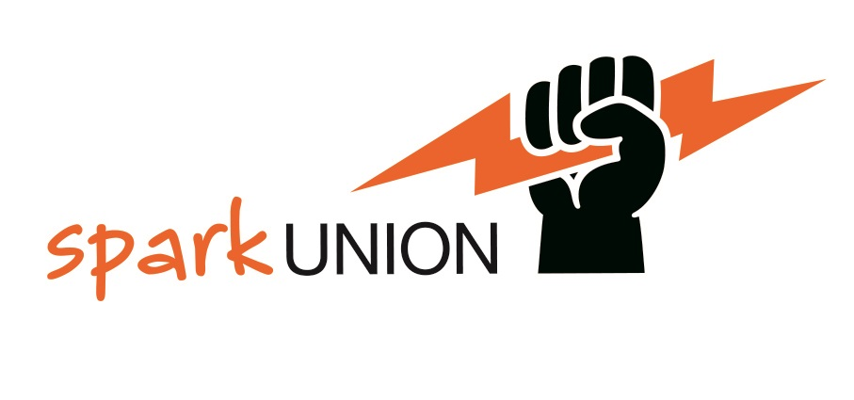
Crisis for Working People in the US!
Unions and worker power in decline
Worker wealth and well-being static since 1970’s while productivity has steadily increased
Unions have attempted to organize new members since 1990’s but have only succeeded in stemming losses
People of color and youth have sought to increase worker power and unions have largely failed to connect to them

Slide 3
New Paradigm: Worker Voice and Agency
Step 1: Popular Education to Build Capacity
What follows is brief example of popular education to create
paradigm shift of the worker struggle
from representation of workers as a third party
to worker agency

Slide 4
30 minute training framed by pre and post surveys: From Union as Third Party Actor to Worker Agency
Pre-training survey: assess base understanding of unions (5 min)
2. Union training (30 minute):
Introduction to Worker Knowledge and Action
Understanding workplace situation
Power analysis
Understand the rules
Make a plan
Small group union problem solving of personal workplace scenario
3. Post-training survey: assess changes in understanding of unions (5 min)

Slide 5
Training Example
Class of sociology graduate students with minimal exposure to unions participate in synchronous online training with a pre and post survey to assess change in view of unions.

Slide 6
Pre-Training Survey Results: Union as Third Party, No Worker Agency
What is Function of Union?
“represent the workers”
“support you when an employer isn’t treating you fairly”
“organization that protects workers rights”
“protect the rights and wellbeing of employees”
No identification of union as an organization of workers

Slide 7
Post-training Survey Results: Worker agency seen in scenario by half of participants
Relationship of workers and union?
“workers play a fundamental role in workplace action by being the change makers”
“incredibly complex”
“unions are mostly helpful for workers”
“[workers] understood how much importance their jobs hold so they knew how powerful this strike could be”
Basic information combined with discussion of their own
scenario changed paradigm for some

